Slide 1
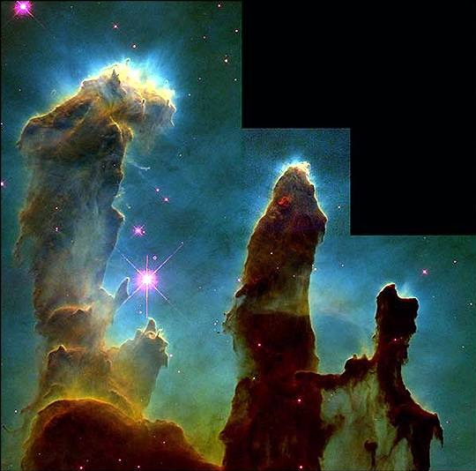
Does God Exist? Is the Bible Accurate?

Slide 2
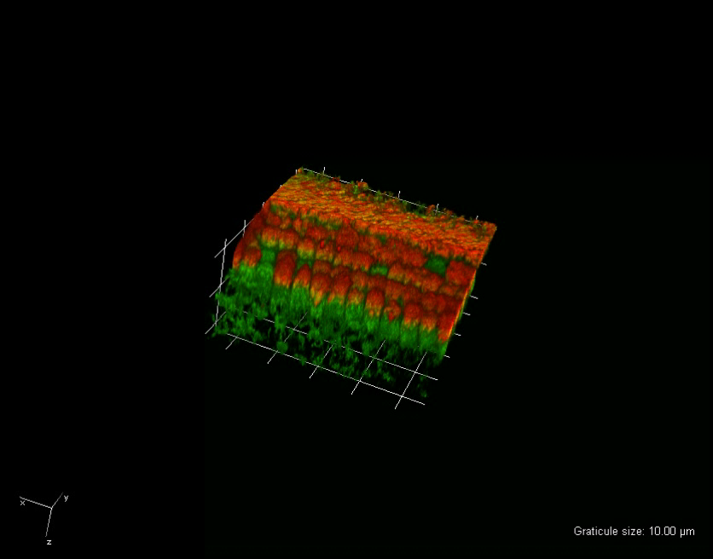
My Experience
Cochlea Cells - 2 Photon Excitation

Slide 3
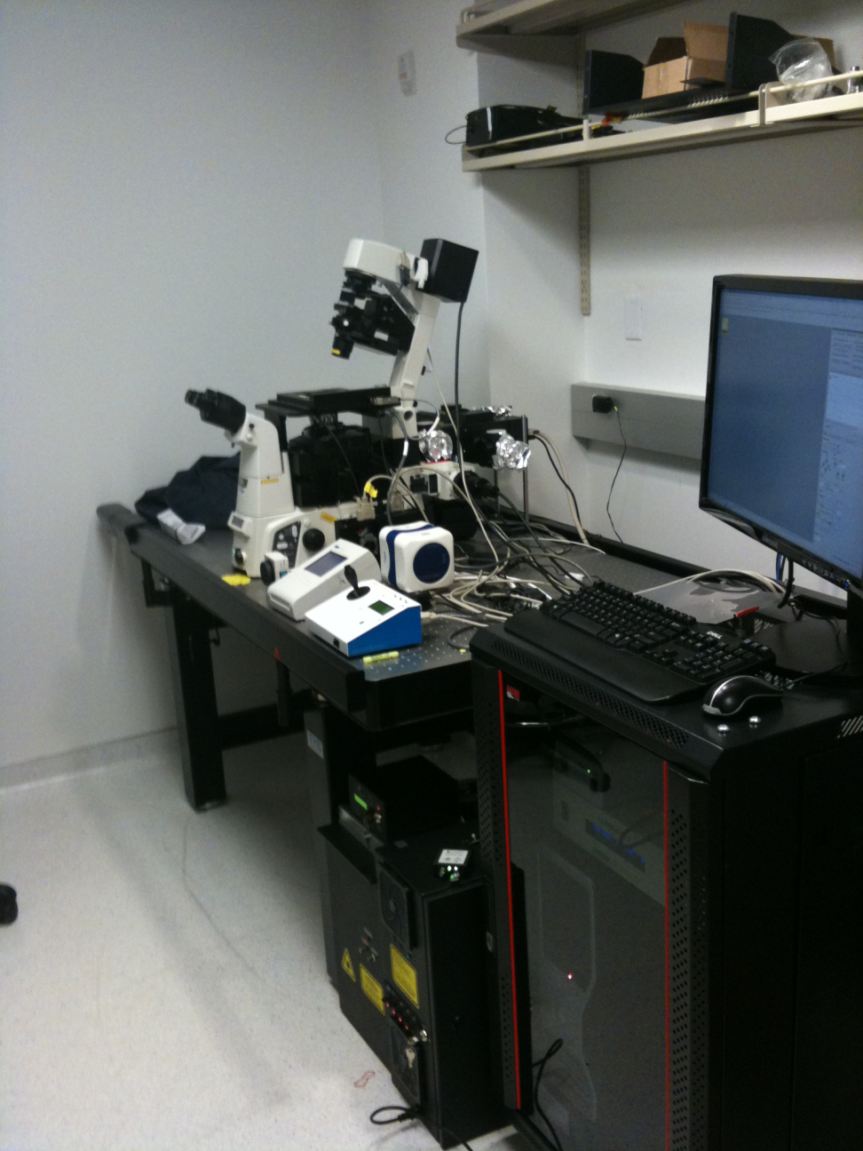
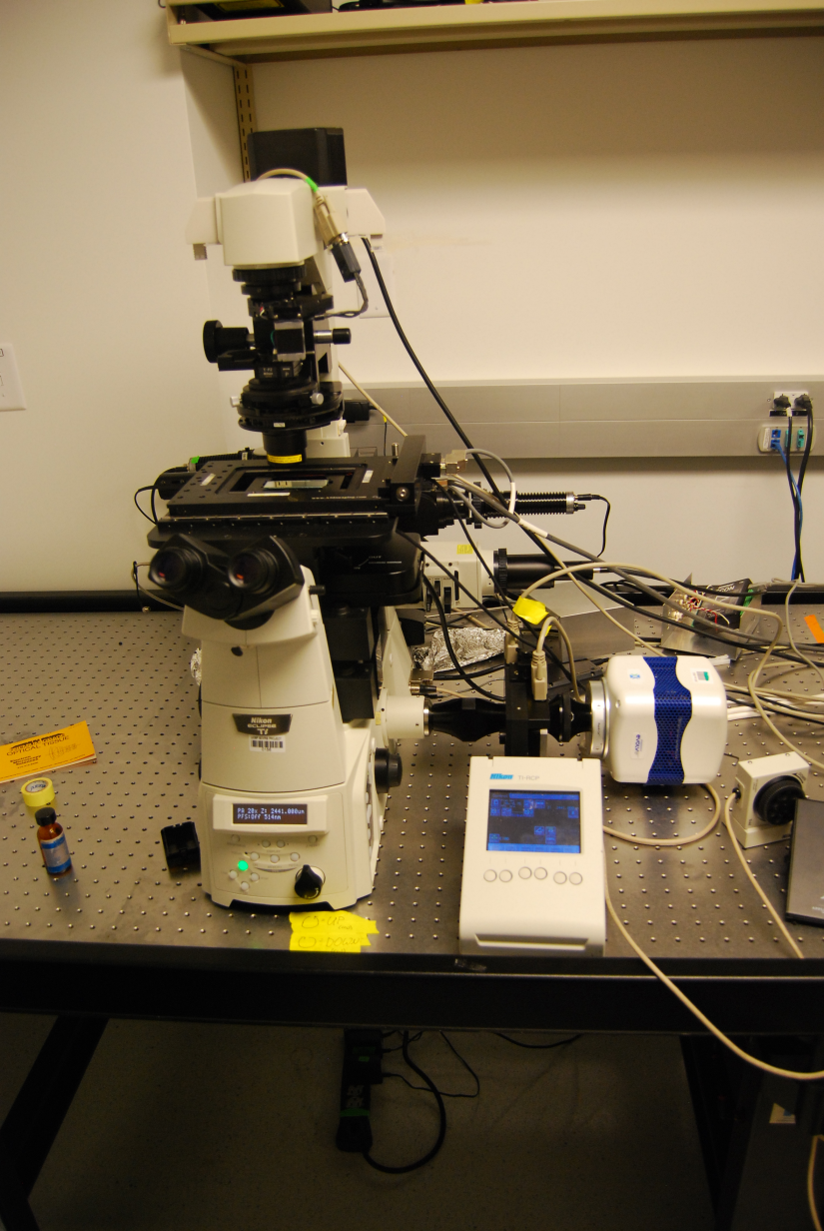
My Experience

Slide 4

My Experience
Solanum lycopersicum(Tomato) Transport

Slide 5
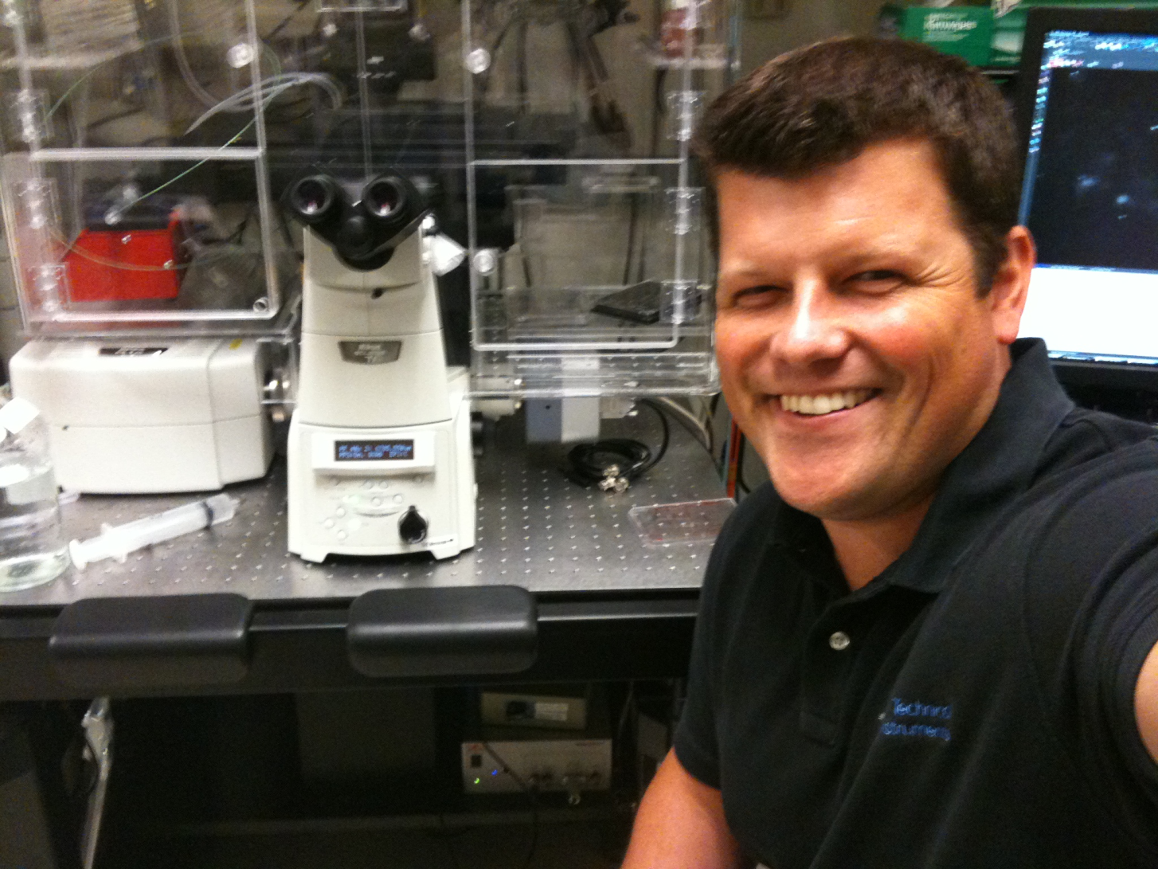
Conclusion
NERD!

Slide 6
Do We Believe?
Is the Bible Accurate?
Can we read the Bible Literally?
Does the Bible conflict with modern scientific evidence?
Is there evidence supporting the literal interpretation of Genesis? (7 Days of creation, flood etc.)

Slide 7
Faith
We all fall to belief in something (2)
  Convinced by evidence (jury trial)
  Assume based on experience (the car will start because it always has)
  Swayed by emotion (“I can sense God’s Love”)
  Disbelief of one faith= Faith in something else.
    “God Cannot exist if there are so many conflicting religions”
    =
    “I have faith God does not exist, because so many religions conflict.”
  …Is either 100% provable/reasonable? both = Faith

Slide 8

The Accurate Bible?
Unequaled Accuracy (Rules for Jewish Synagogue Copyists) (4)
  Locked Columns, letters, line density
  Copied from a certified original
  Counted letters from copy to original
  Copies made in error destroyed

Slide 9
The Accurate Bible?
Compare to other ancient writings : (5)
Author | Written | Earliest Copy in Existence | Time Between Original and Oldest Copy | # of Ancient Copies in Existance
Plato | ~390 BC | 900 AD | 1200 yrs | 7
Aristotle | ~350 BC | 1100 AD | 1400 yrs | 37
Sophocles | ~450 BC | 1000 AD | 1400 yrs | 193
New Testament | 48 AD (Mark) | 130 AD (N.T.) | 80 yrs | 24,630

Slide 10
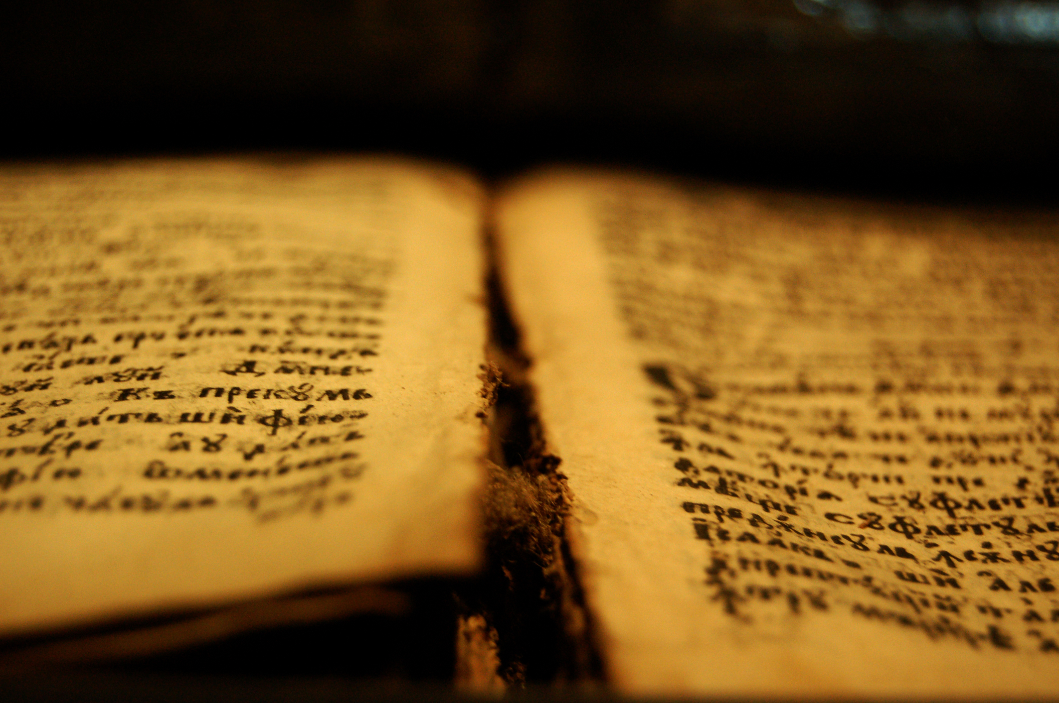
Scientific Facts in OT
Gen 17:12 - Circumcise on the 8th day..(19)
Lev 17:11 - "For the life of the flesh is in the blood.“
Leprosy
  Quarantine (Lev. 13,14,22, Num. 19)
  Wash Hands in running water.
  Lepers’ Clothes Burned (Lev. 13:52)
Earth is a Sphere
  Isa. 40:22 “He sits enthroned above the circle of the earth…”

Slide 11
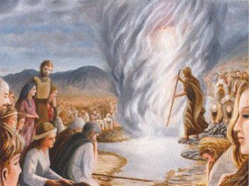

Prophesy
Fulfilled Prophesy:
  Future of the Jews
    Never destroyed (Lev. 26:44)
    Enemy occupation(Lev. 26:32-33)
    Destruction of Temple (Matt. 24:1-2)
  Regional Prophesy of Nations (i.e. Babylon)
    Permanent Overthrow (Isa 13:19)
    Reduced to Swampland (Isa 14:23)
  2,500 Prophesies in the Bible, 2000 fulfilled to the letter… (3)

Slide 12

Conclusions
The Bible in your hands is accurate.
The Bible’s preditions keep coming true.
The Bible can be read literally, not as allegory.

Slide 13
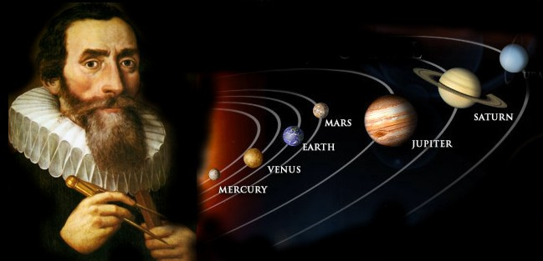
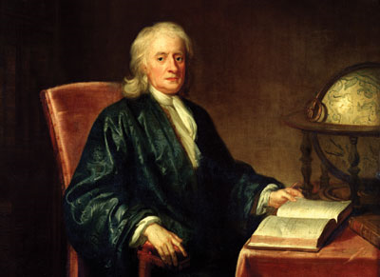
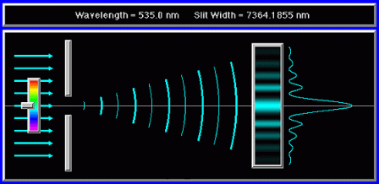
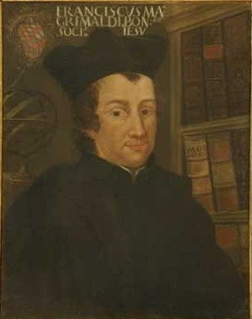
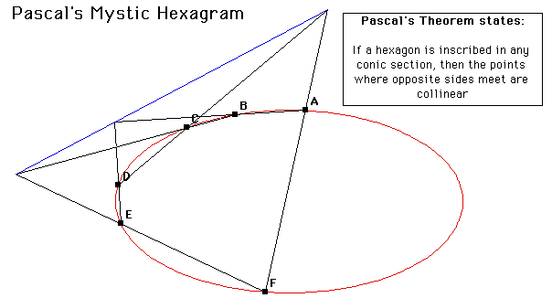
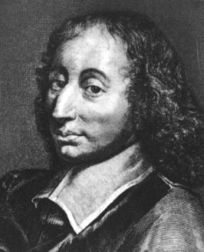
Scientific History – Christians.
Scientists of Faith (6):
Kepler 1571-1630
  Laws of planetary motion.
Boyle 1627-1691
  Founder of modern chemistry
Grimaldi 1618-1663
  Diffraction of light
Pascal 1623-1662
  Hydrodynamics (vacuum)

Slide 14
Evolution Defined
Mutation – Heritable (passed on) changes that “take” over generations (8)
Man Created through a Step-by-step process.(8)
Speciation – Species divide and diversify through mutation. (8)
Process relies on basic tenant of change over time.

Slide 15
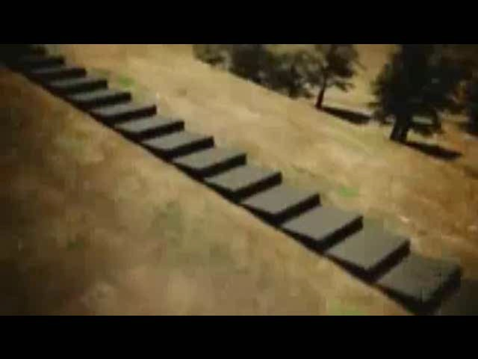
Problems in Evolutionary Theory
Protein Folding (10,10a)

Slide 16

Problems in Evolutionary Theory
Irreducible Complexity

Slide 17
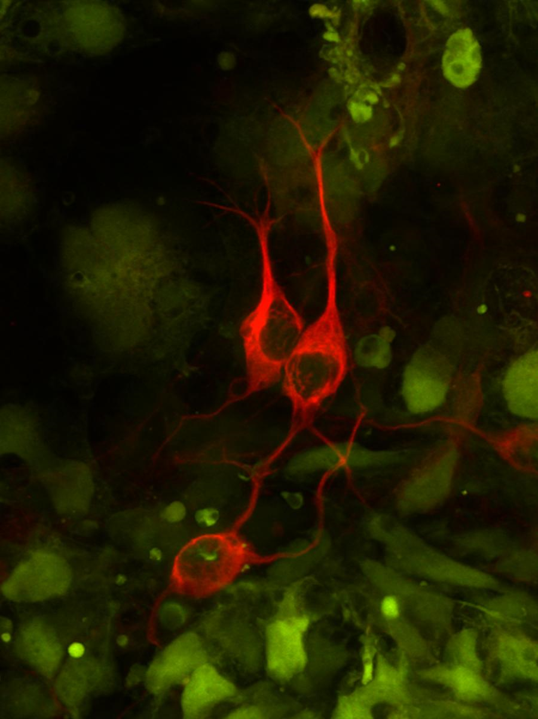
Evidence of Design
DNA & It’s Inherent Complexity
Microbiological Structures and Irreducible Complexity.
Conditions on Earth Perfect for Life
  Sun Perfect Distance
  No Known other Planet to Support Life

Slide 18

Summary
Evolution Cannot explain the level of design and complexity in DNA or in Proteins
Irreducible Complexity Demonstrates Difficulty of Evolution of complex systems.
Statistical Likelihood of Earth being Life Habitable are Rare, or “Miraculous”.

Slide 19

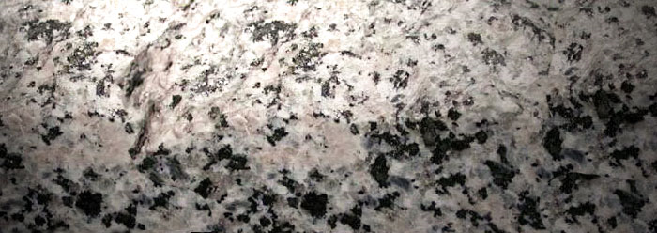

Evidence for a Young Earth
Diamonds and C14(14)
Helium and Granite (15)
Mud in the Sea (16)
***Yet these Observations indicate a cataclysmic Event (Global Flood) in the near past.

Slide 20
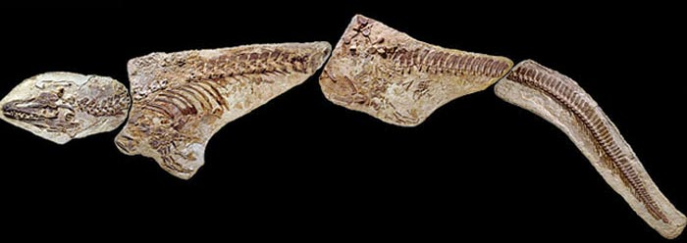
Evidence for a Young Earth
Soft Tissues in Fossils (18)
  Tissue Exists!
  Carbon dated to ~68 million years
  Decay range in 50-100,000yrs.

Slide 21
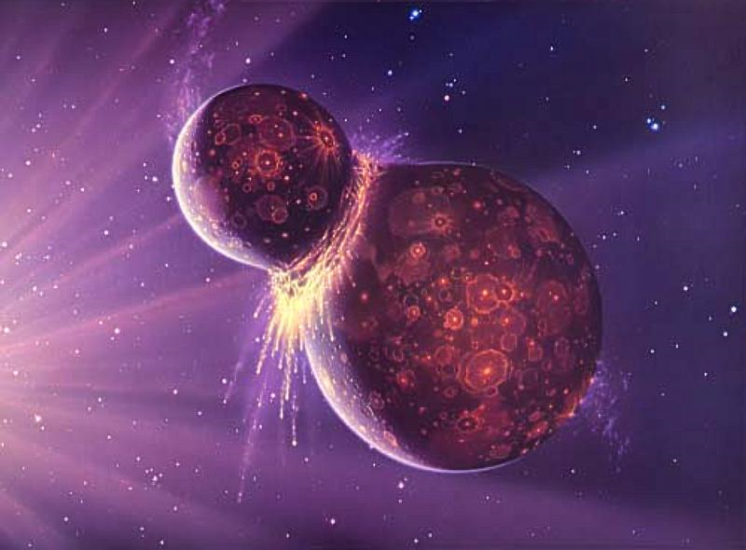
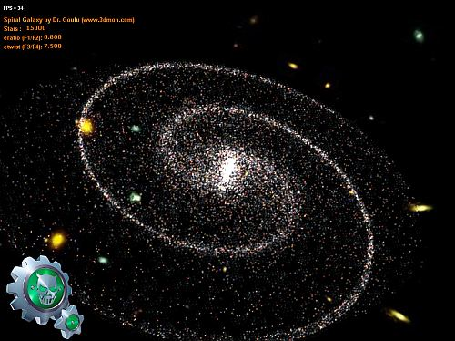
Evidence for a Young universe
Not Enough Supernovas(20)
Spiral Galaxies

Slide 22

Does belief in evolution occupy the intellectual high ground?

Slide 23
Summary
The Bible is accurate.
The Bible can be read literally.
Modern science keeps re-confirming the bible.
There is simply no naturalistic explanation of the origin of life that holds any water.

Slide 24
Conclusion
Rom 1:20 – “For since the creation of the world, His invisible attributes, His eternal power and divine nature have been clearly seen, being understood through what has been made, so that they are without excuse.”

Slide 25

Who’s Driving your life?

Slide 26
References
Webster’s: http://mw1.merriam-webster.com/dictionary/faith
From “A Reason For God” by Timothy Keller: p. xvii
http://www.reasons.org/fulfilled-prophecy-evidence-reliability-bible
http://www.digisys.net/users/ddalton/the_bible_vs__other_ancient_books.htm
http://www.digisys.net/users/ddalton/the_bible_vs__other_ancient_books.htm
http://www.adherents.com/people/100_scientists.html
http://atheism.about.com/b/2008/06/23/nihilist-philosophy-atheism-and-nihilism.htm
http://en.wikipedia.org/wiki/Evolution
http://en.wikipedia.org/wiki/Timeline_of_evolution
http://www.youtube.com/watch?v=3-u0Ptv0Vvg&NR=1
  Axe DD (2010) The case against a Darwinian origin of protein folds. BIO-Complexity 2010(1):1-12. doi:10.5048/BIO-C.2010.1
Birney, E., et. al., Identification and analysis of functional elements in 1% of the human genome by the ENCODE pilot project, Nature 447: 799–816, 2007.
Faulkner, D. 1998. The Young Faint Sun Paradox and the Age of the Solar System. Acts & Facts. 27 (6).
Evolution Ex Nihilo by Henry Morris, Ph.D.
http://www.icr.org/carbon-14/
http://www.icr.org/zircon-helium/
http://www.icr.org/ocean-salinity/
http://www.icr.org/articles/view/4331/257/
http://www.icr.org/article/dinosaur-soft-tissue-biofilm-or-blood-vessels/
http://www.apologeticspress.org/articles/2204
-Davies, K. 1994. Distribution of Supernova Remnants in the Galaxy.

Slide 27
NOTES
Intro: Me –
- 2 Photon of Cochles (inner Ear)
- System at UCSF used for Cell transport studies
- work in Chemistry, biology, engineering, testing.
Do We believe?
Bible is the Inspired Word of God
Bible is Historically Accurate - Earth is ~6-10k old.
Genesis account of creation/flood etc. accurate.
Accurate Bible?
Friend – NASA Researcher – Collector of Coptic Scrolls & Texts
“ The work of Jewish copyists is by far the most accurate available. “
Scientific Facts in OT
Clotting - says infant clotting ability peaks on day 8 – circ before requires K12 injection, K12 peaks Day 8!
Life of the flesh - Blood letting was common practice until 100yrs ago!
Leprosy
- If used during the dark ages black plague could have been mitigated
- standards still basic preventions against disease
Prophesy
Never Destroyed – The jews as a nation “existed” until the creation of the jewish state in 1946
    - Rule over Judah for 70 Yrs (Jeremiah 25:11-12)
    - Babylon Overthorown 50 years after prophesy by Cyrus, who walked through the open gates (as prophesied)
    - Fulfilled today (archeologists limited in recovery by rising water table)
Scientific History
- Based on the assumption of a normal set of test conditions (The “Laws of Nature”)
- Many of the fundamentals of science rest on christian scientists.
Problems in Evolutionary Theory
- Protiens, which form DNA, simply cannot occur through random chance.
Irreducible Complexiity
- Each of the flagella’s items don’t do anything by themselves.
- All, together, are required to form a working system
- Mention blood clotting.
Evidence of design
diamonds
- Natural Diamonds should have formed Millions of yrs ago,
- Carbon 14 should have decayed within 100,000yrs of creation of diamond.
- Natural Diamonds today have measureable levels of C14.
Helium and granite
- black specs on granite are mica
- Zircon crystals naturally form in mica
- Zircon Contains Helium, which Decays at a constant rate.
- Helium diffusion rates indicate an earth age of ~6000yrs.
Mud in the sea
- Erosion Produces ~ 20billion tons of sediment /rock in the oceans per year.
- 1 bn is removed by tectonic activity
- Based on current sediment levels, the earth could be no more than 10M years old, not 3 billion yrs.
- Assuming that a massive global flood took place ~500 yrs ago,
the current sediment level would indicate a 6000 yr old earth.
Mosasaur Fossil
- Retinal Tissue, Scales and other Tissues intact
Young Universe
- Supernovas – Not enough! 1 every 30 years, only a few thousand observed.
  - Spiral Galaxies - Keplerian motion indicates 100-200m yrs. Why are they still there?
Summary
God’s Direction and his creation are abundantly evident all around us.
Who’s Logic should we follow? The unfallabile direction of God, or the constantly in-error logic of man?
Who’s will should we follow? Our own, or God’s?

